Slide 1

HOME LOAN eligibility approval
f

Slide 2
ABSTRACT
With the enhancement in the banking sector lots of people are applying for bank loans but the bank has its limited assets which it has to grant to limited people only, so finding out to whom the loan can be granted which will be a safer option for the bank is a typical process. So in this project we try to reduce this risk factor behind selecting the safe person so as to save lots of bank efforts and assets. This is done by mining the Big Data of the previous records of the people to whom the loan was granted before and on the basis of these records/experiences the machine was trained using the machine learning model which give the most accurate result. The main objective of this project is to predict whether assigning the loan to particular person will be safe or not. This paper is divided into four sections (i)Data Collection (ii) Comparison of machine learning models on collected data (iii) Training of system on most promising model (iv) Testing. In this paper we are predict the loan data by using some machine learning algorithms they are classification, logic regression, Decision Tree and gradient boosting. Keywords: Machine learning, Decision Tree, prediction, Python.

Slide 3
INTRODUCTION
This Problem is done by mining the Big Data of the previous records of the people to whom the loan was granted before and on the basis of these records/experiences the machine was trained using the machine learning model which give the most accurate result. The main objective of this paper is to predict whether assigning the loan to a particular person will be safe or not. We have implemented this loan prediction problem using Decision tree algorithm and data cleaning in Python as there are missing values in the dataset. We use map function for the missing values. The aim of this paper is to apply machine learning technique on dataset. The creditability of a customer for sanctioning loan depend on several parameters, such as credit history, Installment etc.

Slide 4
About the project
Housing Finance company deals in all home loans. They have presence across all urban, semi urban and rural areas. Customer first apply for home loan after that company validates the customer eligibility for loan. Company wants to automate the loan eligibility process (real time) based on customer detail provided while filling online application form. These details are Gender, Marital Status, Education, Number of Dependents, Income, Loan Amount, Credit History and others. To automate this process, they have given a problem to identify the customers segments, those are eligible for loan amount so that they can specifically target these customers.

Slide 5
What is home loan approval
Housing Finance company wants to automate the loan eligibility process based on the customer information and identify the factors/customer segments who are eligible for taking the loan.

Slide 6
DATA SET
The dataset of housing finance company is to predict the approval of loan on bank details .
Dataset:
i)test
ii)train
LINK FOR DATASET : https://drive.google.com/drive/u/0/folders/19IGtxjS9yzadVkMUVsBtNQ97T8ydYE1W

Slide 7
Data PRE PROCESSING
Data preprocessing is most important process. Mostly healthcare related data contains missing vale and other impurities that can cause effective- ness of data. To improve quality and effectiveness obtained after mining process, Data preprocessing is done. To use Machine Learning Techniques on the dataset effectively this process is essential for accurate result and successful prediction. For diabetes dataset we need to perform pre processing in two steps:

Slide 8
Data PRE PROCESSING
1)Missing Values removal- Remove all the instances that have zero (0) as worth. Having zero as worth is not possible. Therefore this instance is eliminated.
2) Splitting of data- After cleaning the data, data is normalized in training and testing the model. When data is spitted then we train algorithm on the training data set and keep test data set aside.

Slide 9
ALGORITHM
1)DECISION TREE:
2)LOGISTIC REGRESSION:
1)DECISION TREE:
Decision Tree- Decision tree is a basic classification method. It is supervised learning method. Decision tree used when response variable is categorical. Decision tree has tree like structure based model which describes classification process based on input feature. Input variables are any types like graph, text, discrete, continuous etc. Steps for Decision Tree Algorithm-
Construct tree with nodes as input feature.
Select feature to predict the output from input feature whose information gain is highest.
The highest information gain is calculated for each attribute in each node of tree.
Repeat step 2 to form a subtree using the feature which is not used in above node.

Slide 10
ALGORITHM
2)LOGISTIC REGRESSION:
Logistic regression is one of the most popular Machine Learning algorithms, which comes under the Supervised Learning technique. It is used for predicting the categorical dependent variable using a given set of independent variables.
Logistic regression predicts the output of a categorical dependent variable. Therefore the outcome must be a categorical or discrete value. It can be either Yes or No, 0 or 1, true or False, etc. but instead of giving the exact value as 0 and 1, it gives the probabilistic values which lie between 0 and 1.

Slide 11

Steps to predict eligible house loan
Step3:
Split the dataset in train and test
Step 1:
Import required packages and datasets
Step2:loan status and handling missing data

Slide 12
Steps to predict eligible house loan
Step 6:
Build the model for above mentioned machine learning algorithm on test set
Step 4:
By selecting machine learning algorithm like decision tree..etc
Step5:
Build the model for above mentioned machine learning algorithm on train set

Slide 13
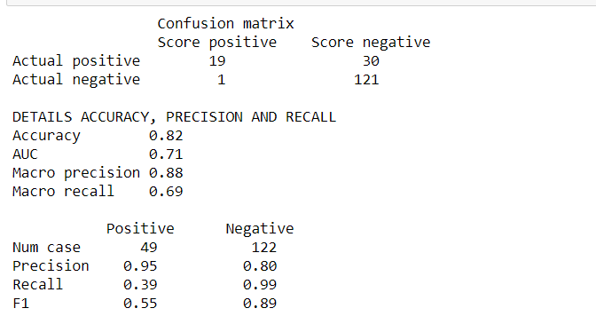
ReSULT ANALYSIS
USING DECISION TREE ALGORITHM:

Slide 14
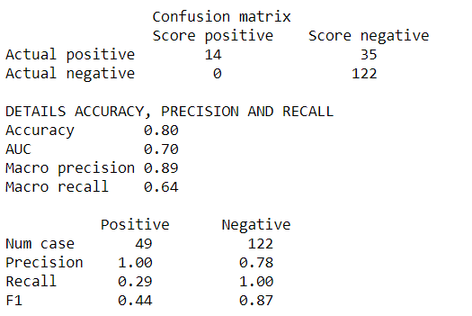
ReSULT ANALYSIS
USING LOGISTIC REGRESSION

Slide 15
conclusion
The analytical process started from data cleaning and processing, Missing value imputation with mice package, then exploratory analysis and finally model building and evaluation. The best accuracy on public test set is 0.82. This brings some of the following insights about approval. Applicants with Credit history not passing fails to get approved, Probably because that they have a probability of a not paying back. Most of the Time, Applicants with high income sanctioning low amount is to more likely get approved which make sense, more likely to pay back their loans. Some basic characteristic gender and marital status seems not to be taken into consideration by the company.

Slide 16

Thank You!
A .SAI VAMSHI KRISHNA
CH. MANISH
E .SHAHSI KIRAN REDDY
K .THARUN REDDY
T. HARI HARA NANDAN

